Slide 1

< webdev-group1 = "cyber sentinels" />
Password
Generator;
'acebo' 'felizardo'
'dayot' 'torres'
'duerme’
12 | 21 | 2023

Slide 2

Brothers of Builder (BOB) Company is facing a security challenge as their employees are using weak passwords, sharing login credentials or jotting down passwords on insecure platforms, resulting to potential security breaches data leaks and unauthorized access to confidential information.
< section = "01" />
the problem;

Slide 3
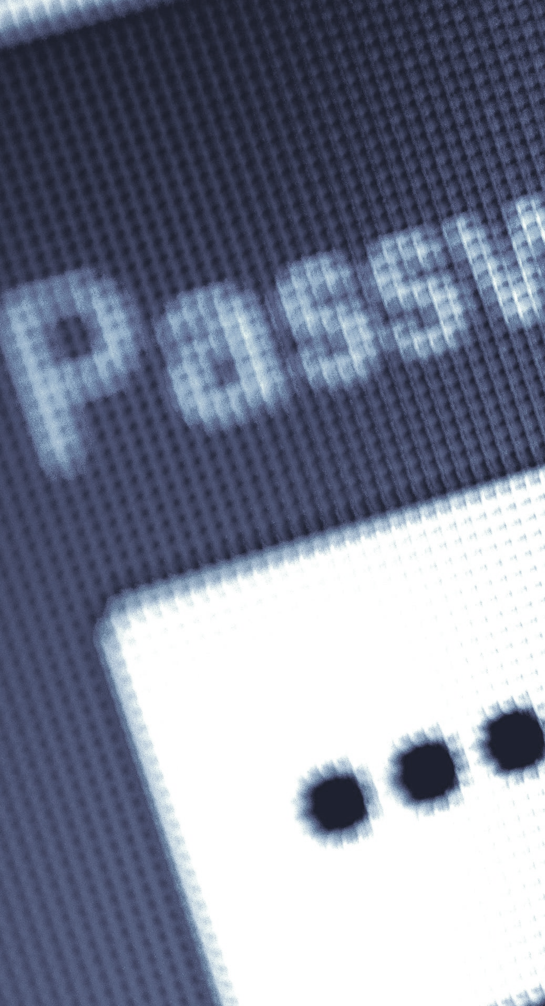
< section = "02" />
system requirements
1
4
Customize password length ranging from 4 to 20 characters
A user-friendly
and interactive UI
2
5
HTML, CSS, and JavaScript will be use for this project
Clipboard for easy copy and pasting
3
Checkbox for:
- uppercase letters
- lowercase letters
- numbers
- special characters

Slide 4
< section = "??" />
scopes and
limitations

Slide 5
< section = "??" />
flow chart

Slide 6
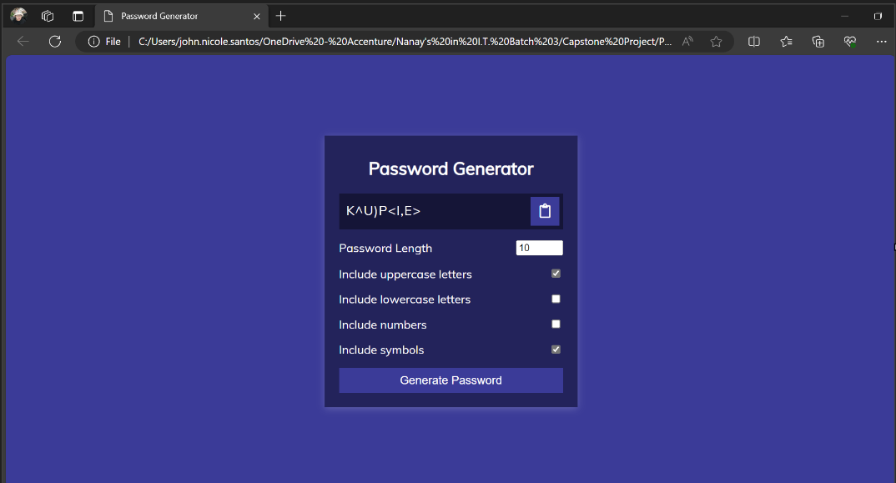
< section = "??" />
expected
output
The sample layout/output is not the final product and can be subject to change

Slide 7
?
Q and A
< just ask away />

Slide 8
end of presentation;
< presented by />
web dev group 1: cyber_sentinels
Acebo, Jovelyn Felizardo, Jennifer
Dayot, Gia Celine Torres, Prince
Duerme, Ma. Angeline

